Slide 1

Az National Trucking Data Analysis
Group 9 Rajesh Bhattacharjee rxb210045
Christopher David Colley cdc102020
Sindhura Pendyala sxp210202
Hashmeet Kaur Behal hxb210003
Vedashree Suhas Paithankar vxp210005

Slide 2
Problem Statement and Objectives
Identify top risky commercial truck drivers in United States by understanding the risk involved in their truck movements
Identify top risk factors of truck drivers based on various aspects like Latitude, Longitude, City, events, total miles, average velocity and Gas Consumption
Ensuring that the truck drivers follow the rules and regulations of the ANT corporation to increase the safety and not leading to accidents involving factors like speeding, unsafe following distance, lane departure and unsafe tail distance

Slide 3
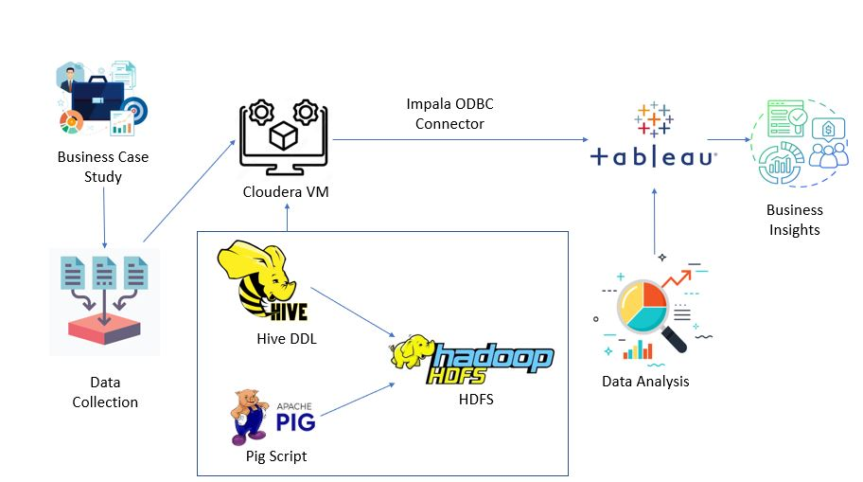
Analysis Workflow Diagram

Slide 4
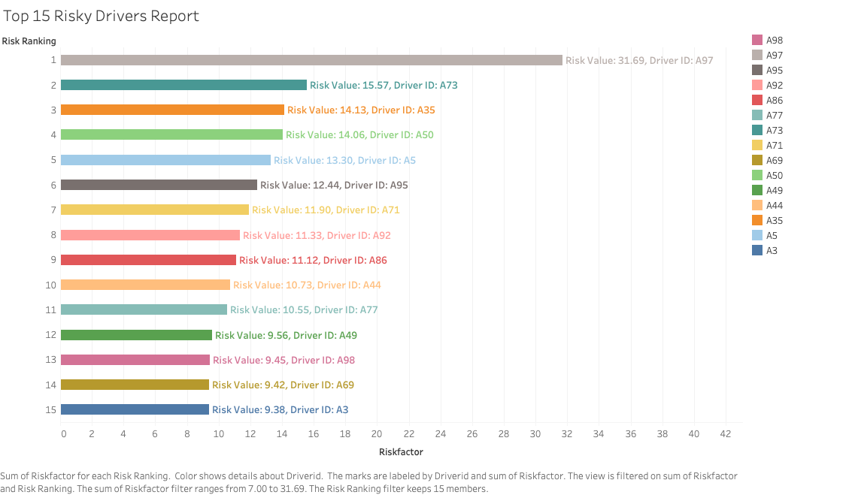
Top 15 Risky Drivers

Slide 5
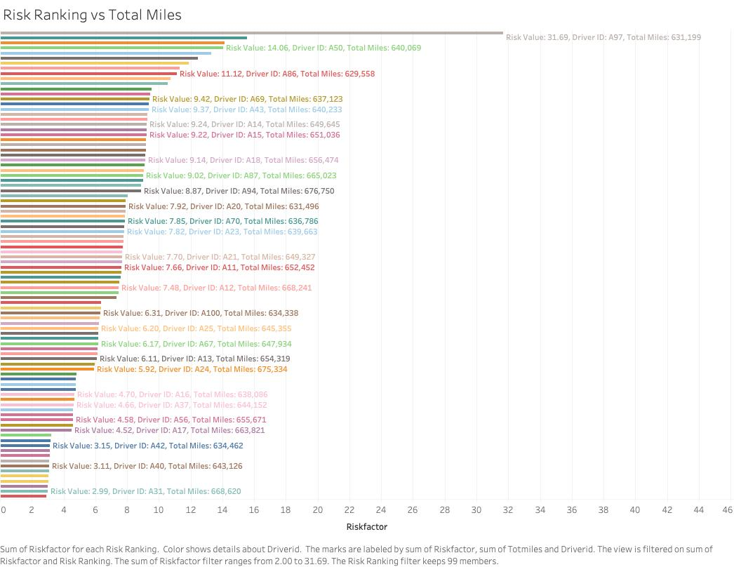
Risk Ranking Vs Total Miles driven
Upon determining the risk factor for each driver, many drivers with Risk Score more than threshold amount of 7 were observed
The bottom 2 values in the chart with compliant risk score around 3 have driven more miles (643K & 653K) than the top 3 non-compliant drivers (631K, 640K, 629K respectively)
Throughout the data spectrum randomness can be observed

Slide 6
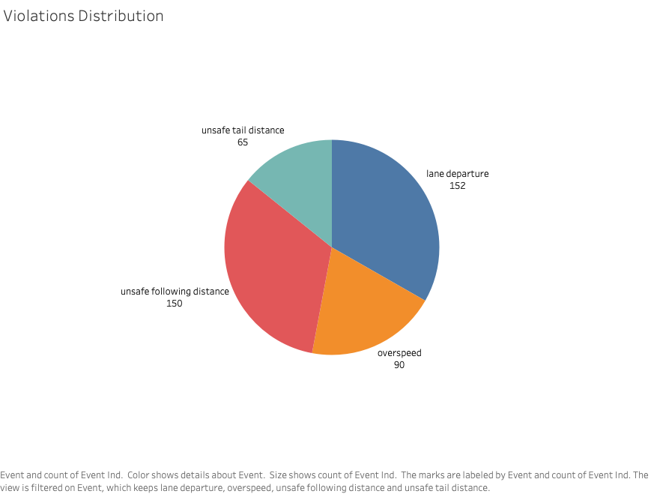
Violations Distribution
Lane departure has highest violations comparatively to unsafe tail distance having lowest

Slide 7
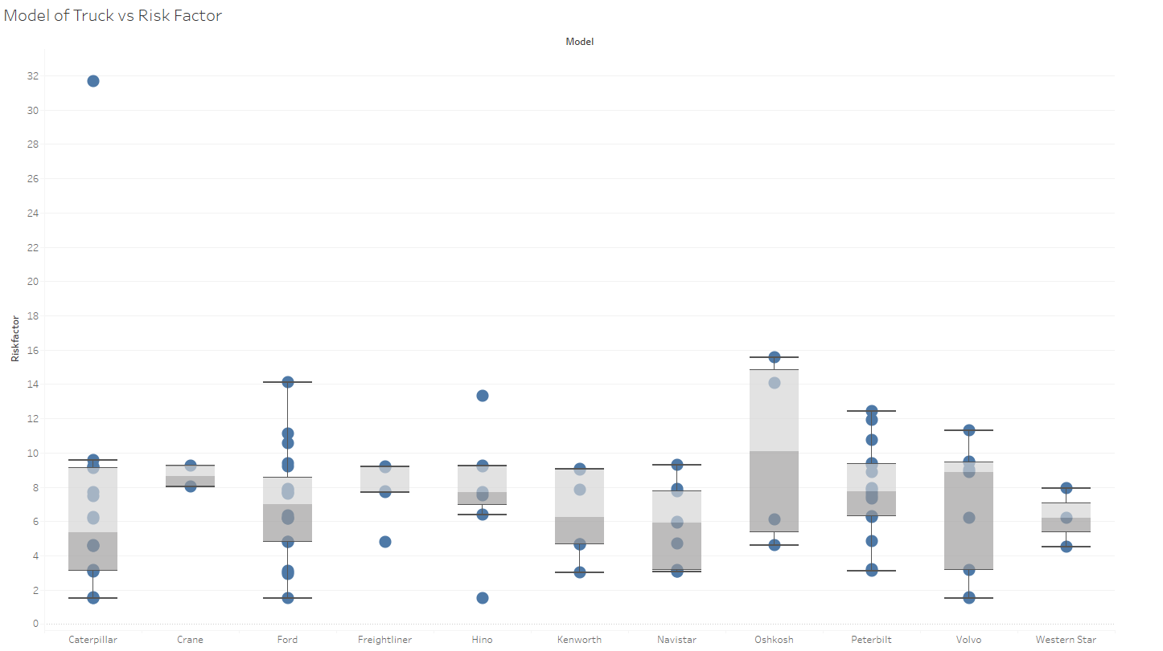
Model of Truck vs Risk Factor Distribution
According to Model of the Truck, we can interpret that Model Oshkosh is the riskiest Truck

Slide 8
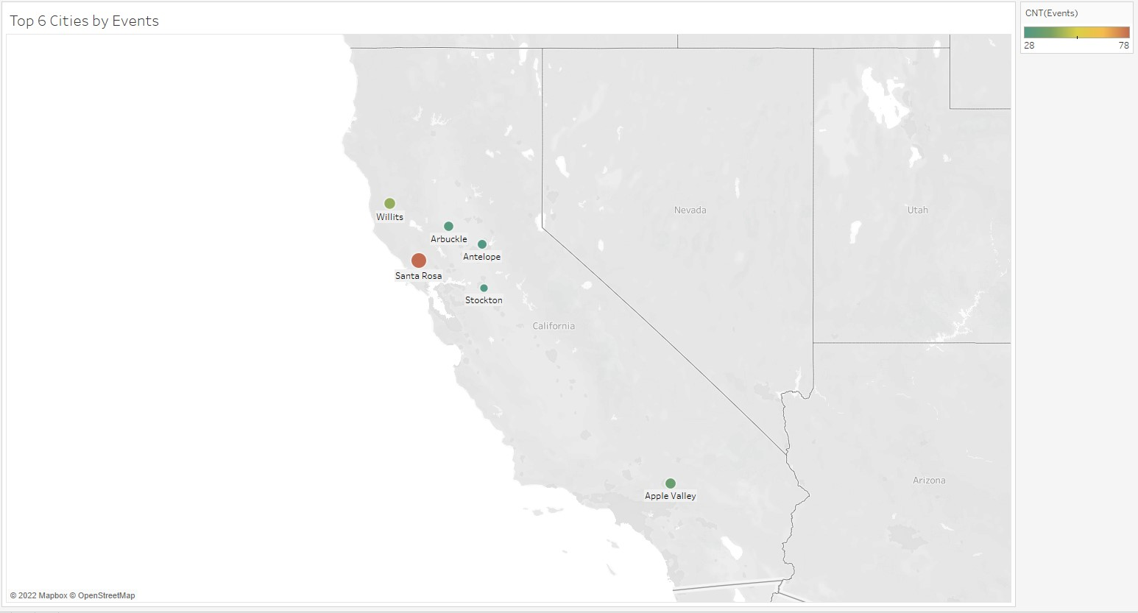
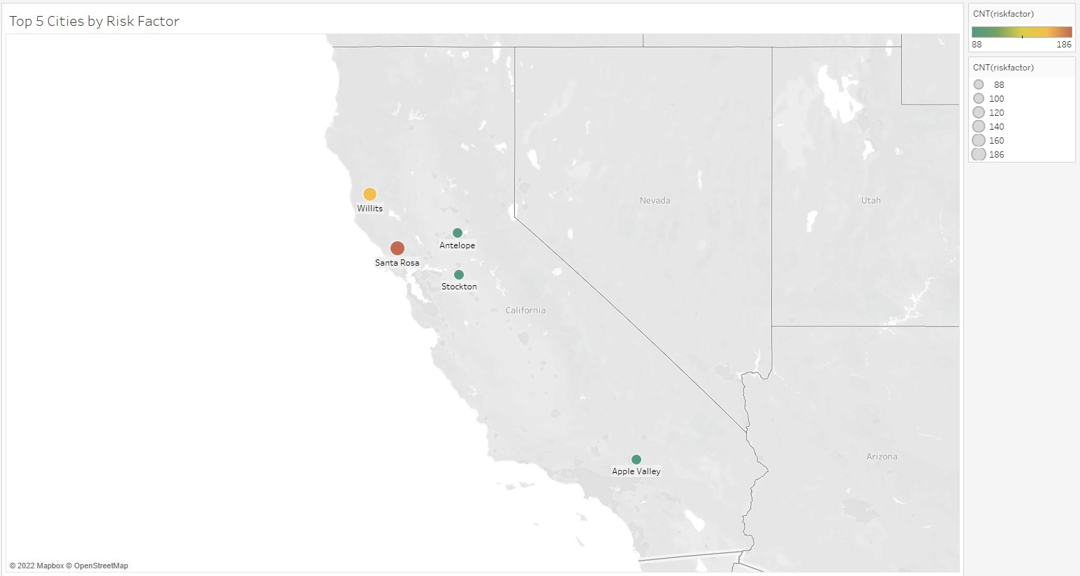
Top Cities with most Number of Events and Risk Factor

Slide 9
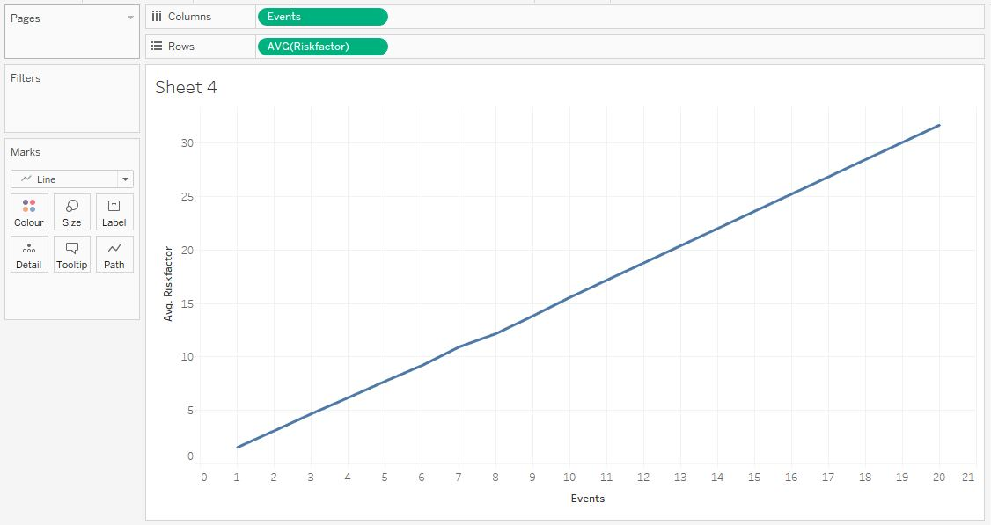
Avg Risk factor vs Number of Events
The Average Risk factor vs Events chart shows the increasing nature of risk factor with respect to the number of events

Slide 10
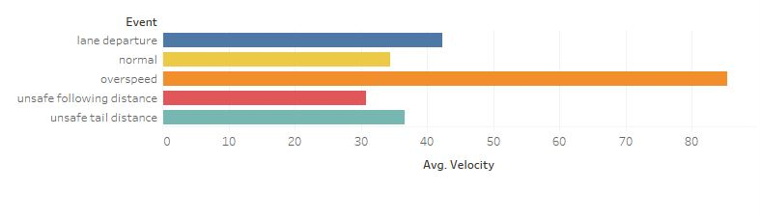
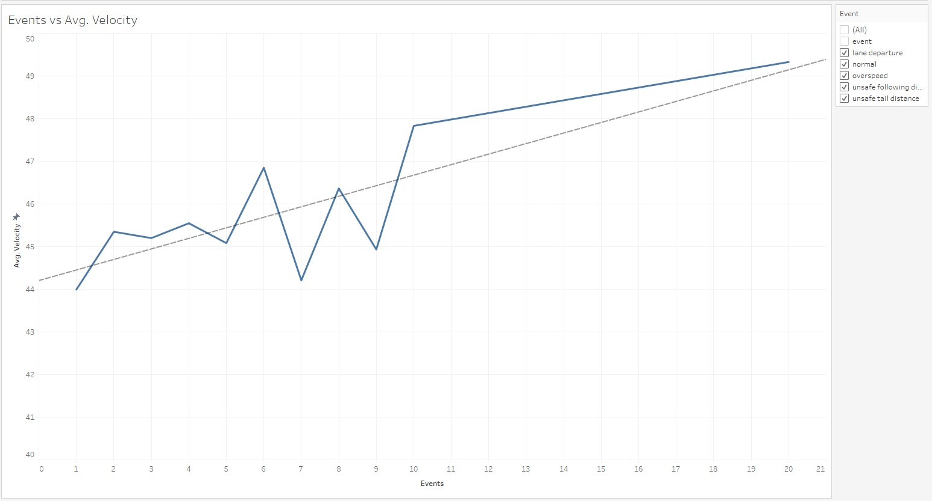
Event vs Average Velocity
These charts show event wise average velocity and their linear relation using a trend line
Also, we can see drop in average velocity at 7 and 9 events with almost constant increasing velocity after 10 events

Slide 11
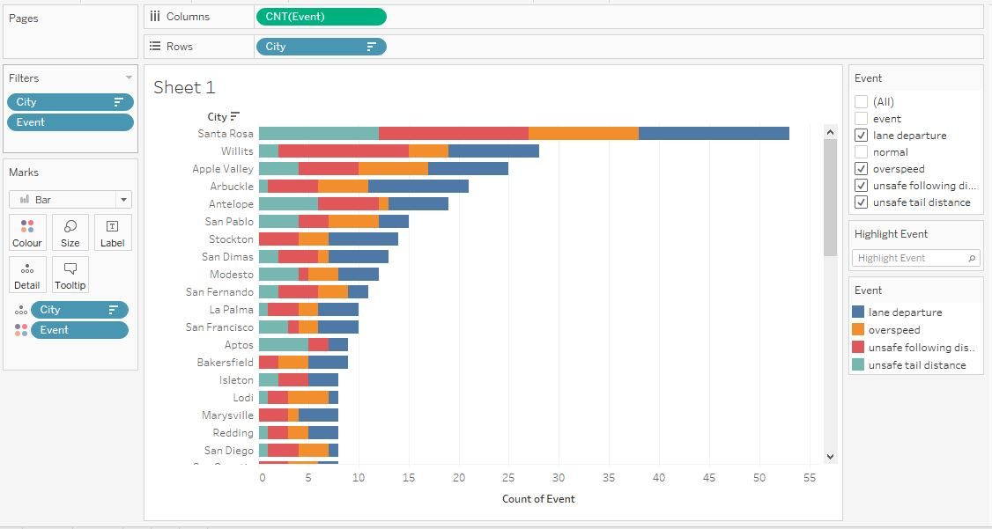
City wise Events

Slide 12
Conclusion
Conclusion

Slide 13
Thank you

